Slide 1
SAMPLING THEORY
DOYEL SARKAR

Slide 2
MEANING
In simple words sampling consists of obtaining information from a larger group or a universe

Slide 3
TERMINOLOGIES
A population is the entire group that you want to draw conclusions about.
A sample is the specific group that you will collect data from. The size of the sample is always less than the total size of the population.

Slide 4
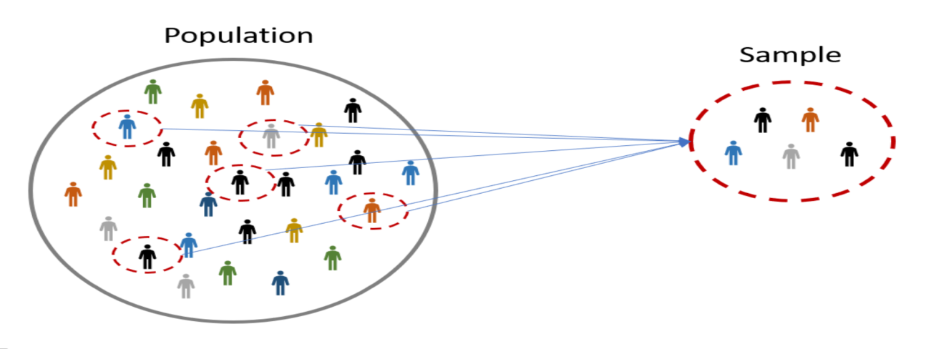

Slide 5
Size of population & sample
Population size : The total number of units present in the population.
Usually denoted by N
Sample size : The number of units present in the sample
Usually denoted by n

Slide 6
What should be the desired characteristics of a Sample?
A proper sample must give a precise but correct picture of the population from which it is drawn.
The sample must be obtained by probability process.
The sample should be as small as precision considerations permit
It should be as economical as possible and gathered swiftly to be completed within the time schedule.

Slide 7
SAMPLING
The process of drawing samples from populations is called sampling.

Slide 8
Types of sampling
Random sampling
Purposive sampling
Stratified sampling
Systematic sampling
Cluster sampling

Slide 9
Random sampling
When every member has equal chance to be included in the sample

Slide 10
Statistics and Parameters
A statistic is a numerical value computed from a sample or A statistic is a function of sample observations. Its value may differ for different samples. e.g. sample mean, sample standard deviation , and sample proportion .
A parameter is a numerical value associated with a population. Considered fixed and unchanging. e.g. population mean μ, population standard deviation σ, and population proportion p.

Slide 11
What is a sampling distribution of a statistic?
The sampling distribution of a statistic is the distribution of all possible values taken by the statistic when all possible samples of a fixed size n are taken from the population. It is a theoretical idea—we do not actually build it.
The sampling distribution of a statistic is the probability distribution of that statistic

Slide 13
EXAMPLE
Suppose that a committee consists of 5 members. The number of children of each of them is given below
If a random sample of size 2 is selected with out replacement from the population , find the sampling distribution of the sample mean.
Member | A | B | C | D | E
No. of Children | 2 | 1 | 0 | 3 | 2

Slide 14
Solution

Slide 15
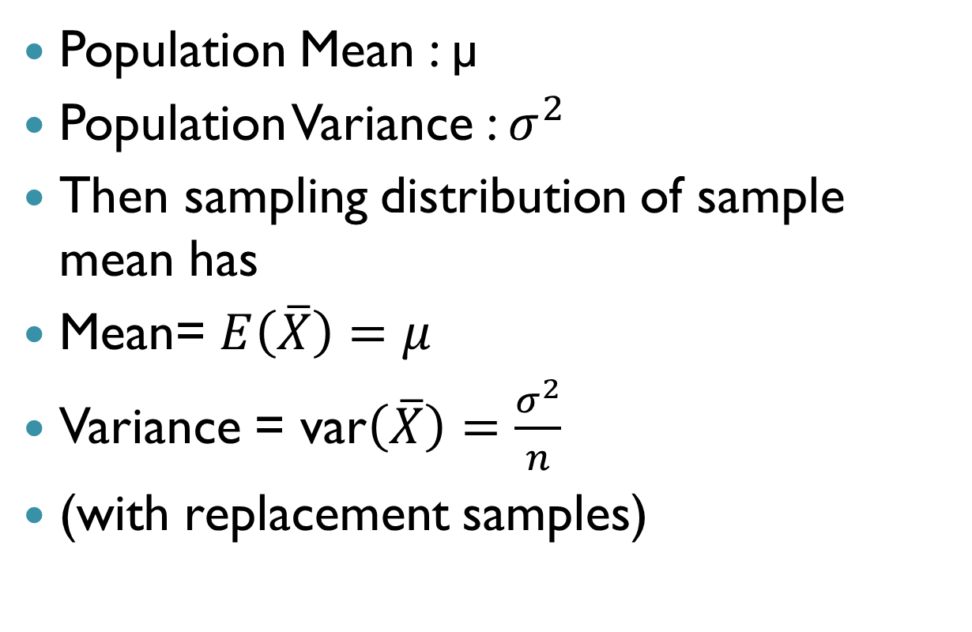
Sampling distribution of sample mean
Population Mean : µ
Population Variance : $σ^{2}$
Then sampling distribution of sample mean has
Mean= $E\left(\overline{X}\right)=μ$
Variance = var$\left(\overline{X}\right)=\frac{σ^{2}}{n}$
(with replacement samples)

Slide 16
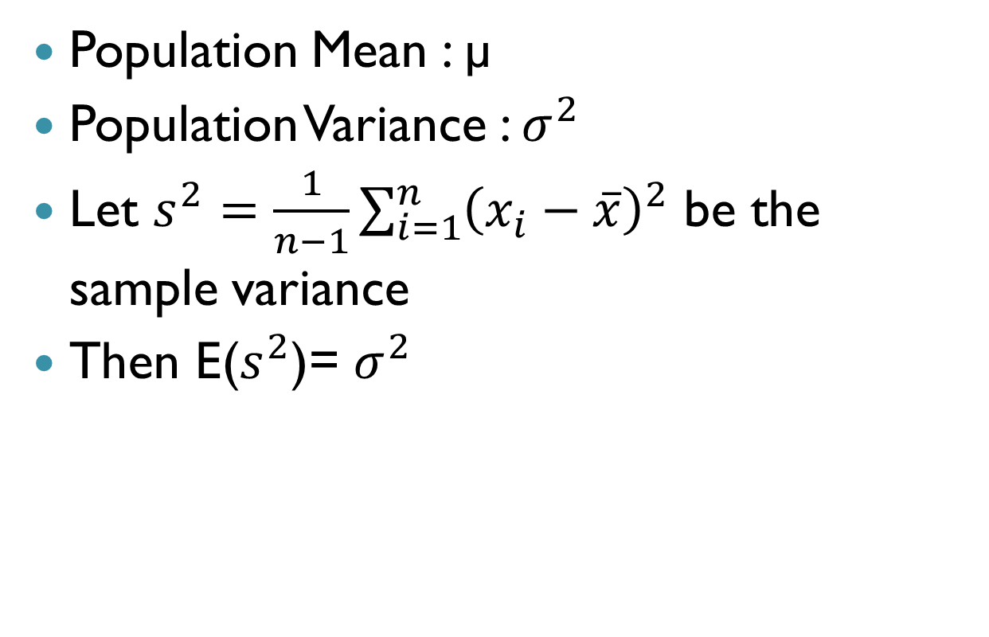
Sampling distribution of sample Variance
Population Mean : µ
Population Variance : $σ^{2}$
Let $s^{2}=\frac{1}{n−1}\sum_{i=1}^{n}{{\left(x_{i}−\overline{x}\right)}^{2}}$ be the sample variance
Then E($s^{2}$)= $σ^{2}$

Slide 17
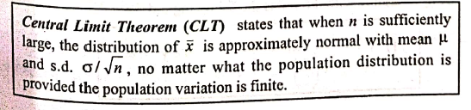
CENTRAL LIMIT THEOREM

Slide 18
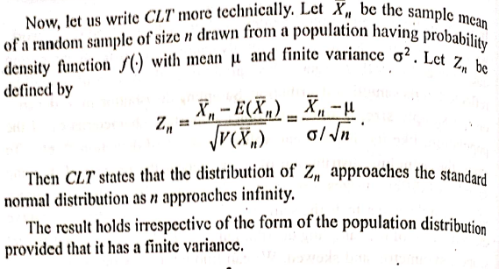
CLT

Slide 19
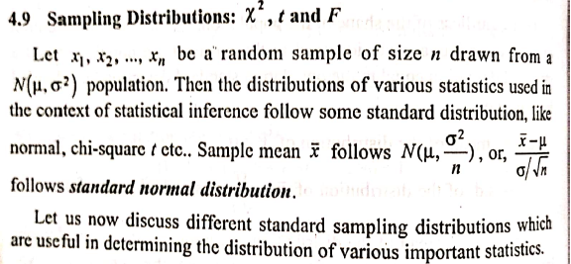
Some special distributions

Slide 20
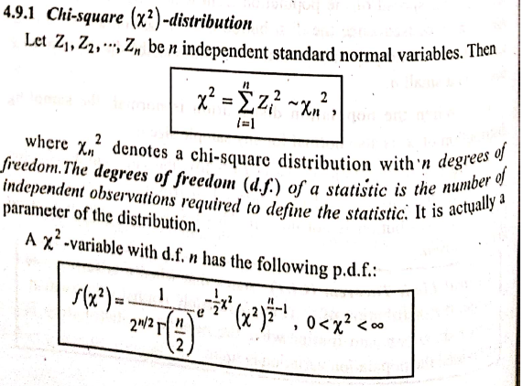
Chi square

Slide 21
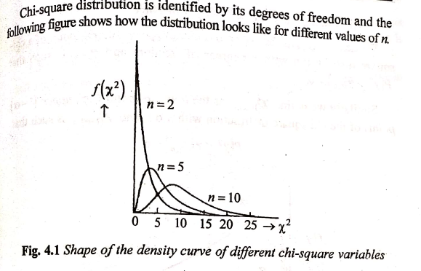

Slide 22
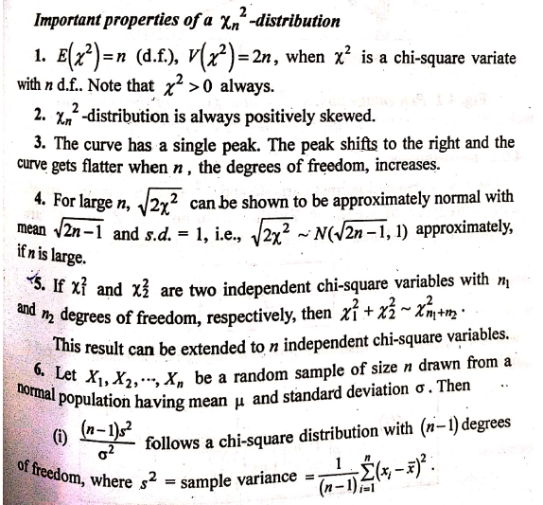

Slide 23
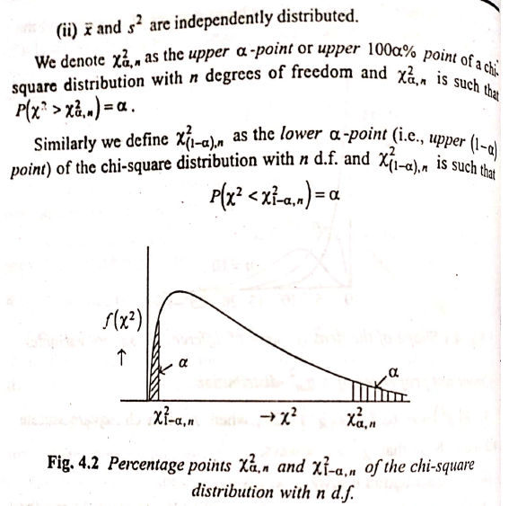

Slide 24
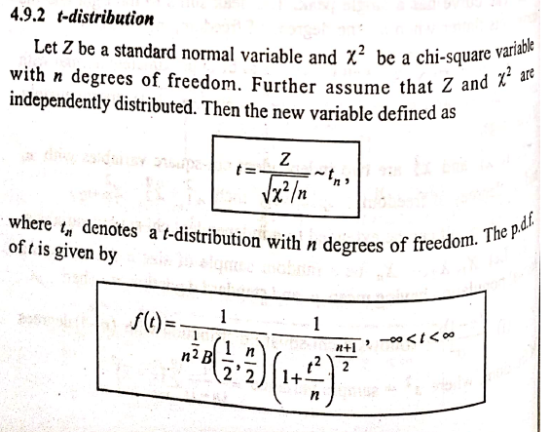
T distribution

Slide 25
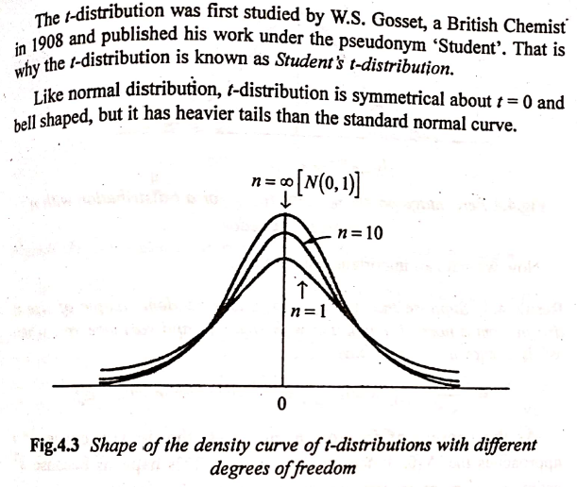

Slide 26
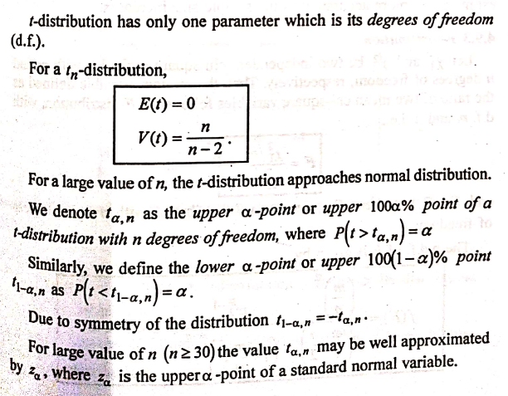

Slide 27
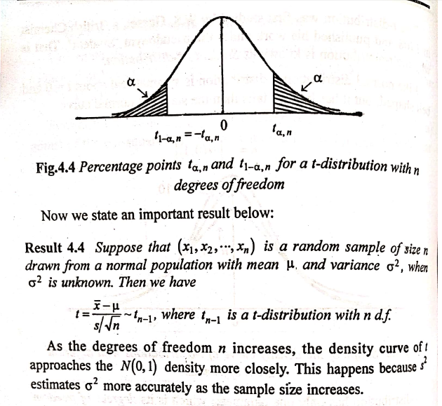

Slide 28
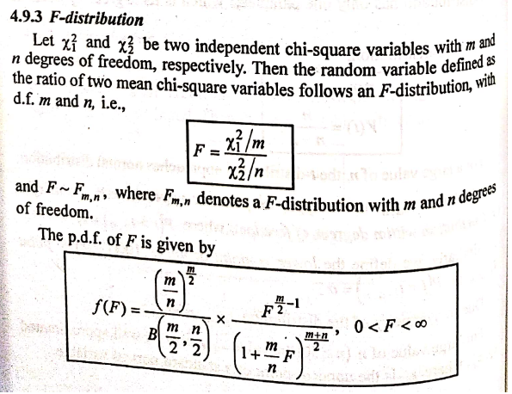

Slide 29
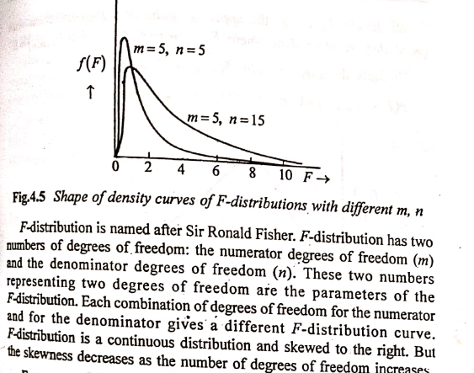

Slide 30
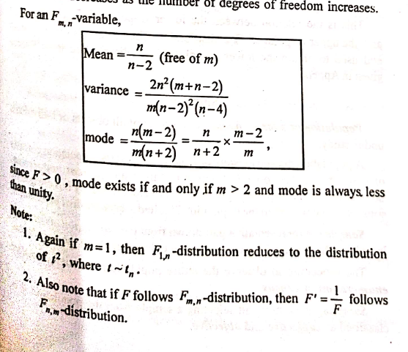

Slide 31
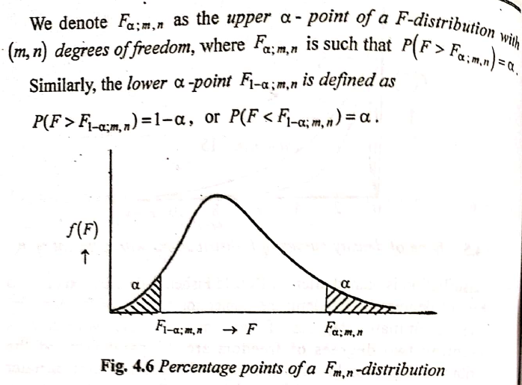

Slide 32
